Slide 1

1. Introduction to Limits and Behaviour of Logic

Slide 2
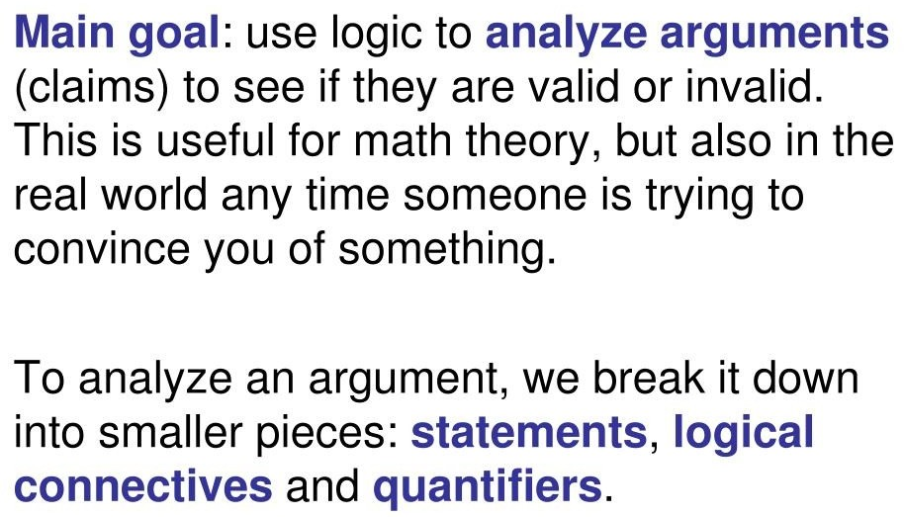
1.1 Logic

Slide 3
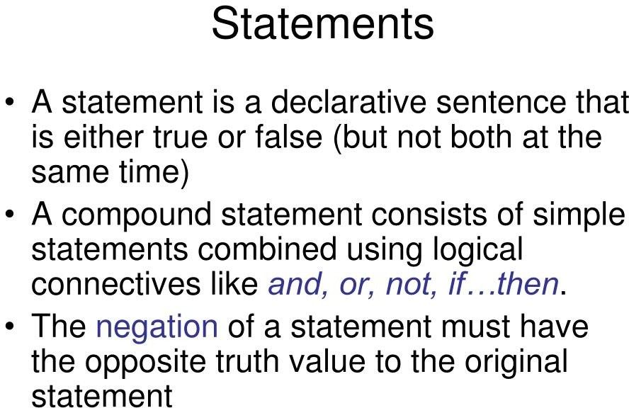

Slide 4
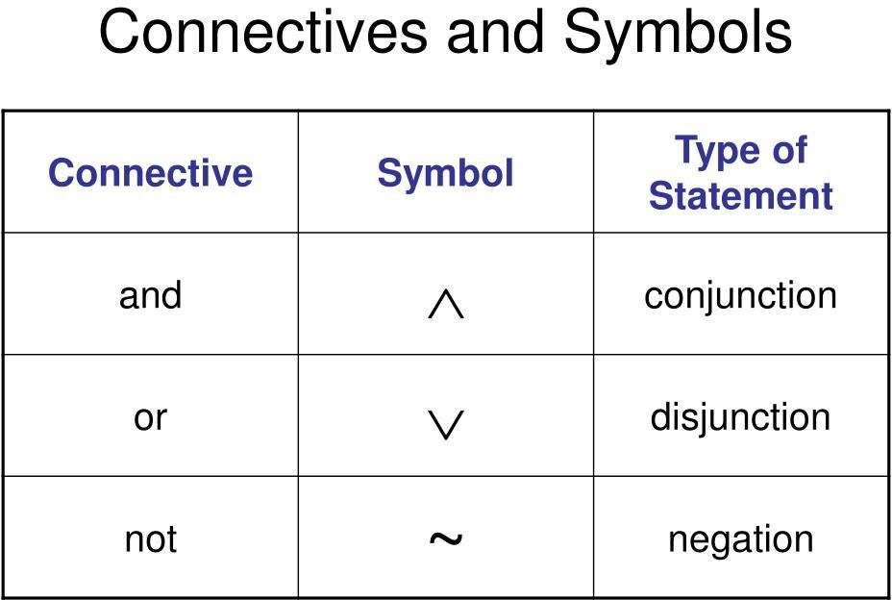

Slide 5
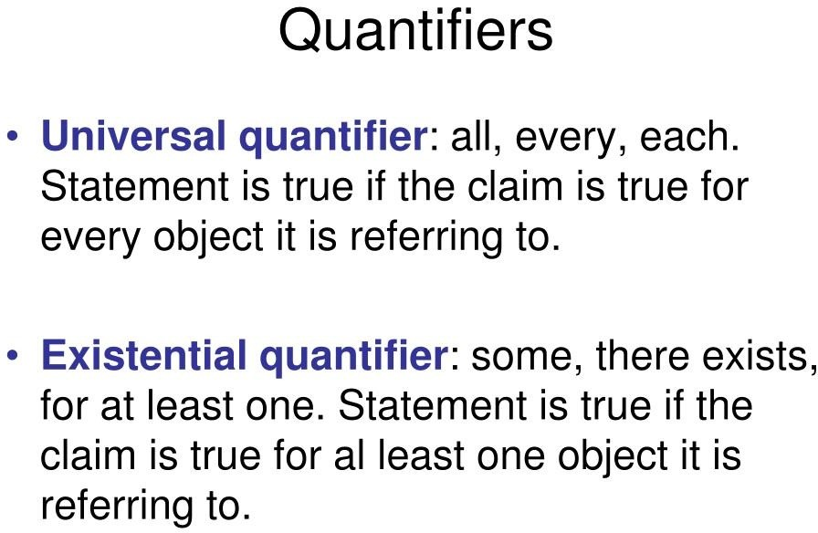

Slide 6
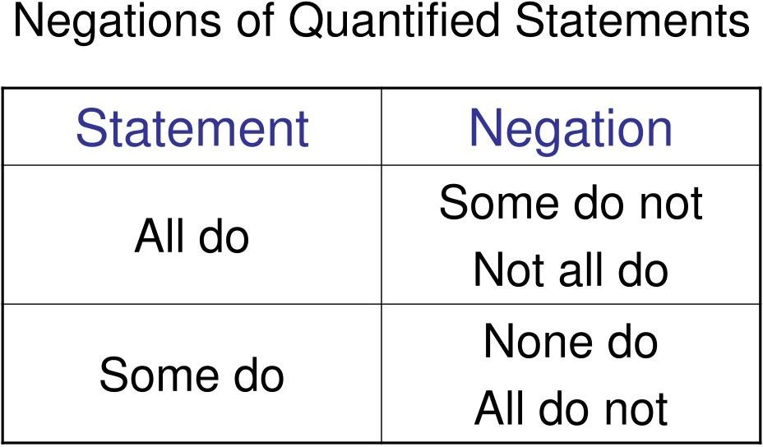

Slide 7
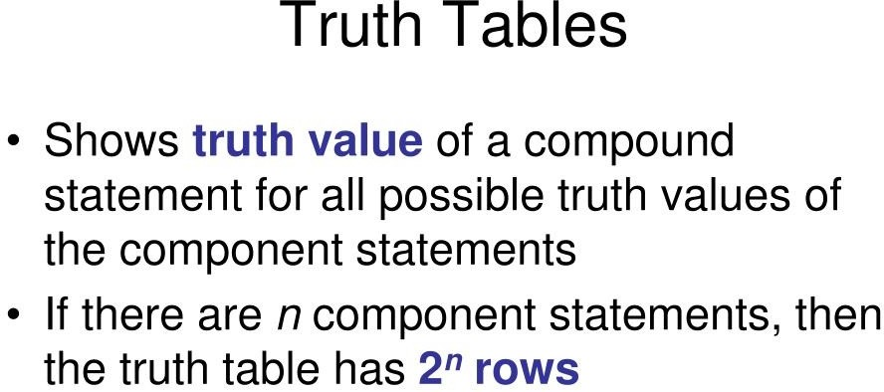

Slide 8
Behaviour of logic
Behavior is what something does in reaction to external requests and events, but also self-driven innate actions, even without an external stimulus.

Slide 9
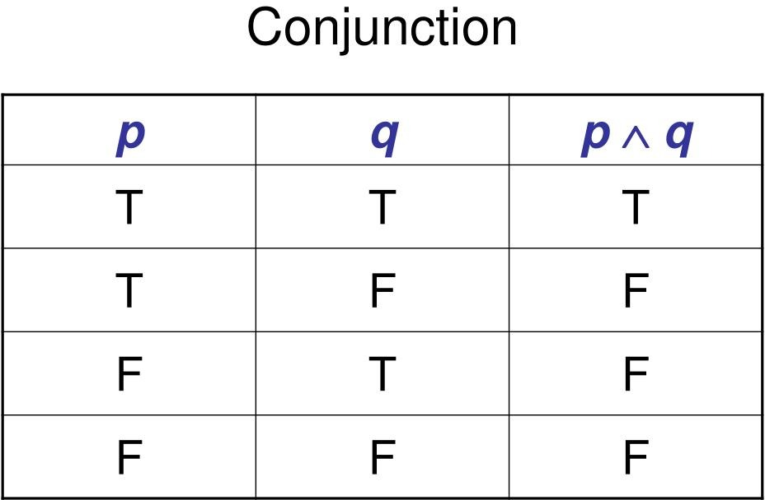

Slide 10
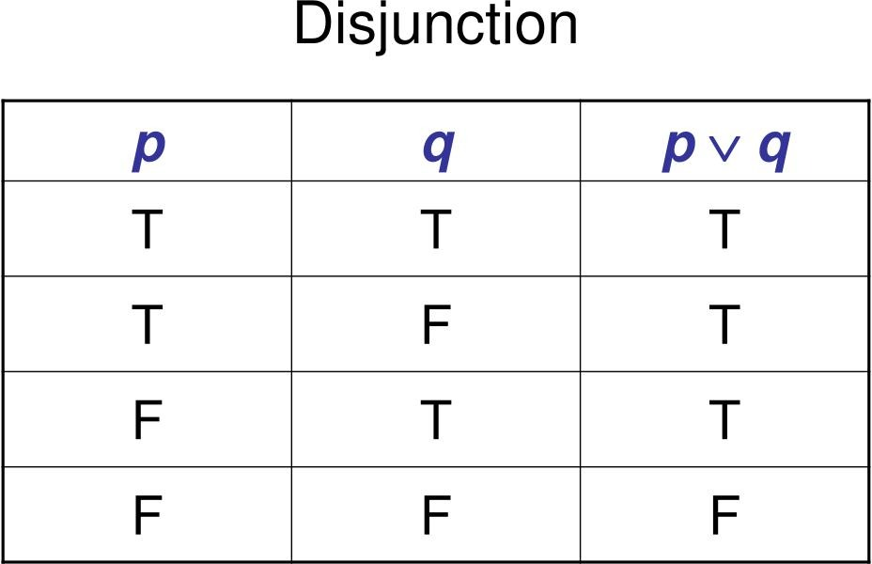

Slide 11
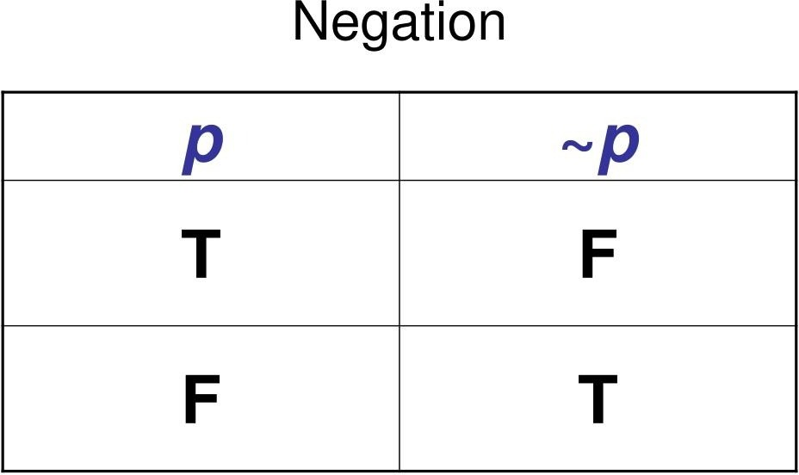

Slide 12
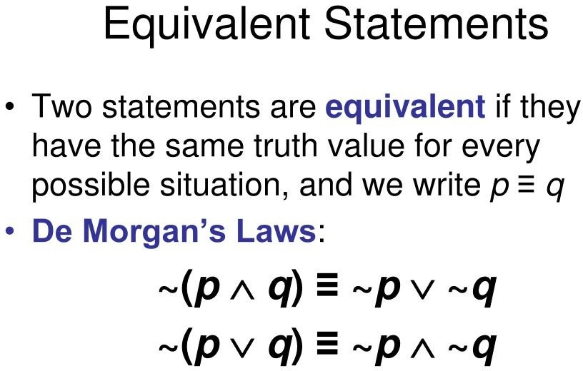

Slide 13
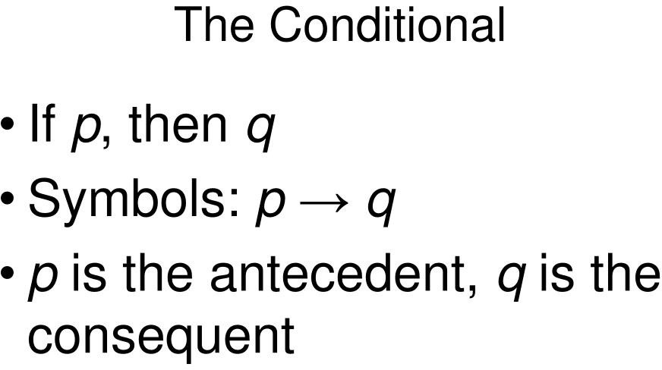

Slide 14
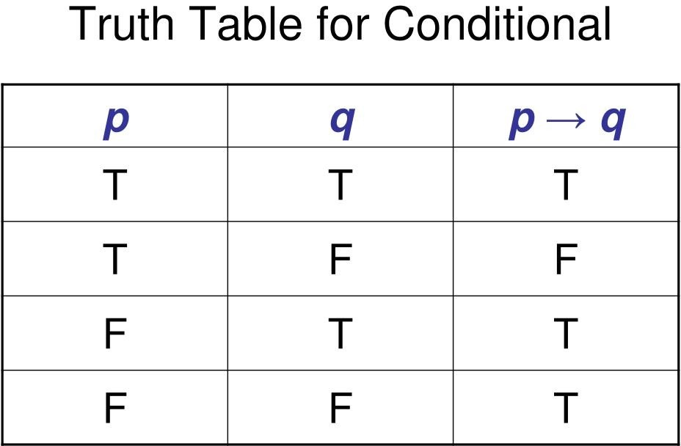

Slide 15
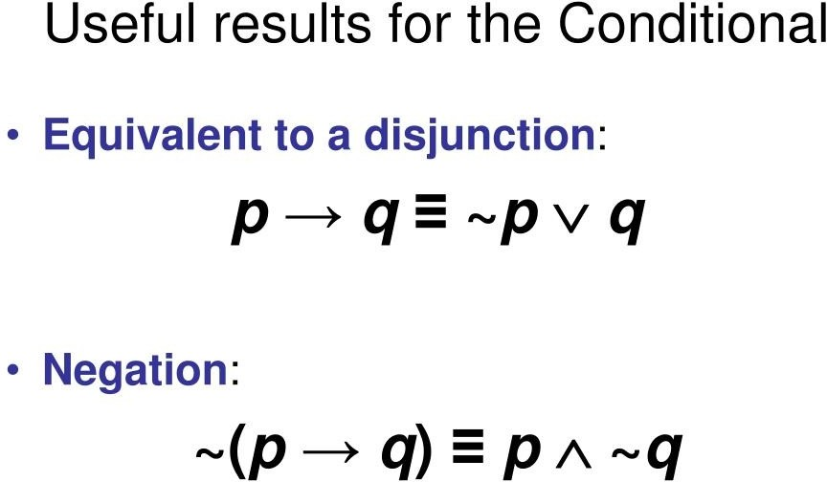

Slide 16
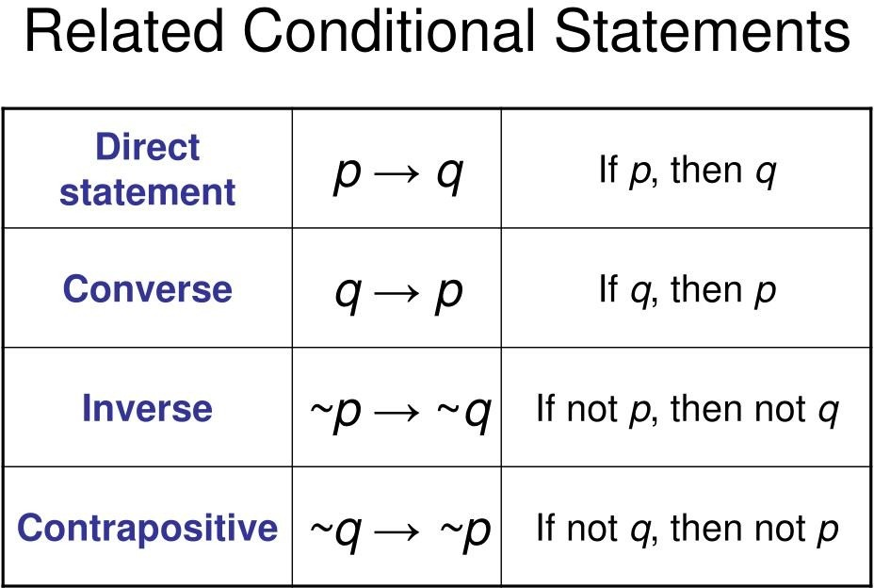

Slide 17
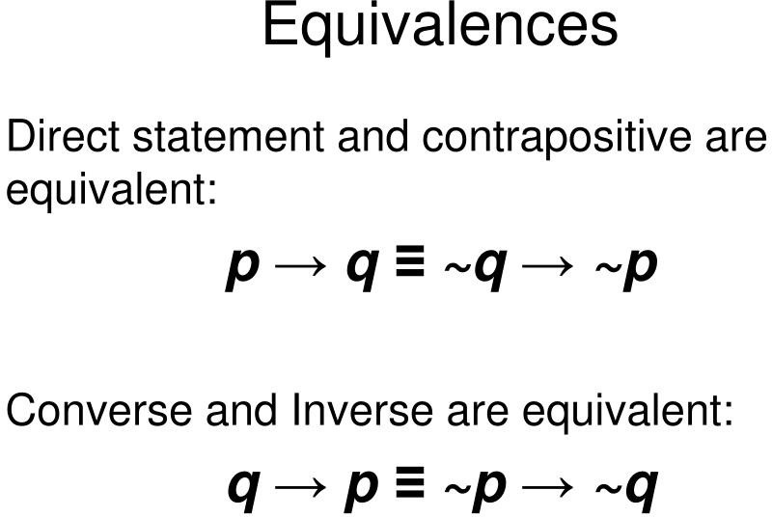

Slide 18

1.2 Limits of Algorithms / Logic

Slide 19

Computational Limits and Constraints
Theoretical limits: Concepts like Turing machines, the Halting Problem, and undecidability illustrate that some problems cannot be solved by any algorithm
Practical limits: Hardware constraints and real-world applicability
The Halting Problem: Determining if a given program will halt or run forever is undecidable
P vs. NP Problem: Whether every problem whose solution can be verified quickly can also be solved quickly

Slide 20
Hardware constraints
How much energy can you put in a chip without melting it?
How fast can you flip a bit in your silicon memory?
How big can you make your computer and still fit it in a room?

Slide 21

1.3 Behaviour of Logic in Algorithms
Algorithms use logical constructs to make decisions and control flow
Common constructs: conditional statements , loops , and recursion
Conditionals: Affect the number of operations based on input conditions
Loops: Can significantly impact performance, especially nested loops
Recursion: Can lead to elegant solutions but may also cause stack overflow if not managed properly

Slide 22

2. Understanding Taxonomy in Worst Case

Slide 23
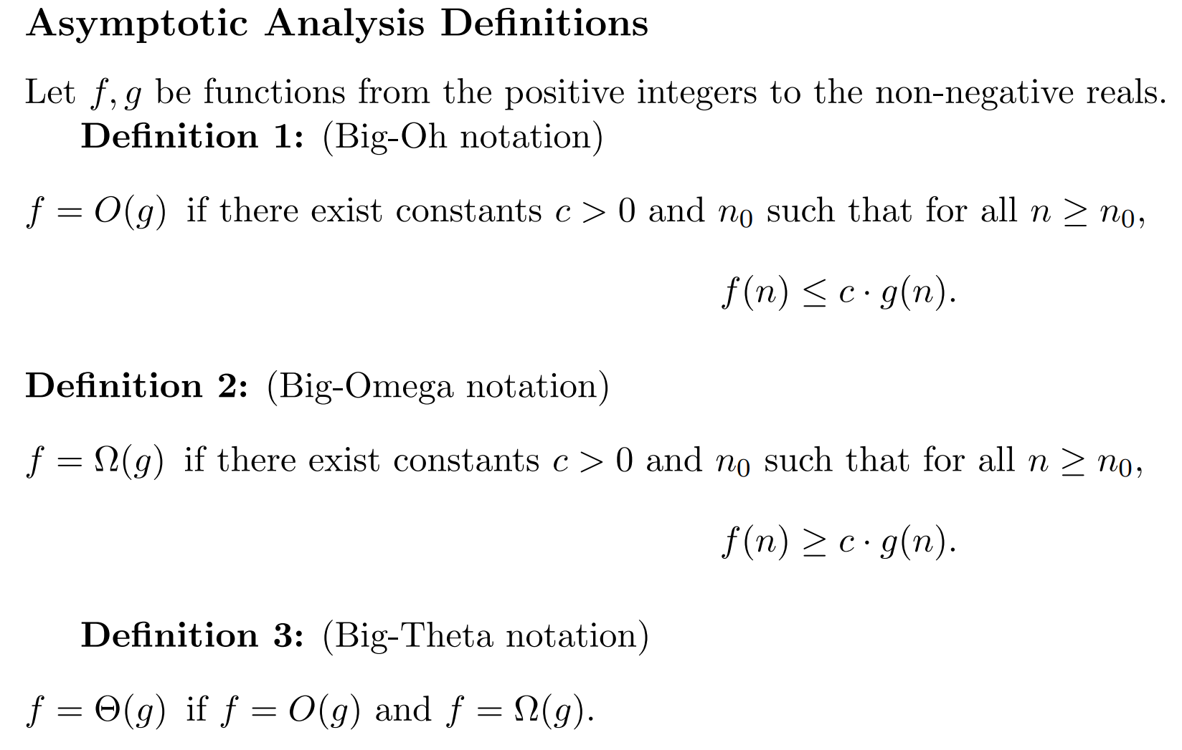
Notes:
https://web.stanford.edu/class/archive/cs/cs161/cs161.1236/Sections/Section1/Section1_Solutions.pdf

Slide 24
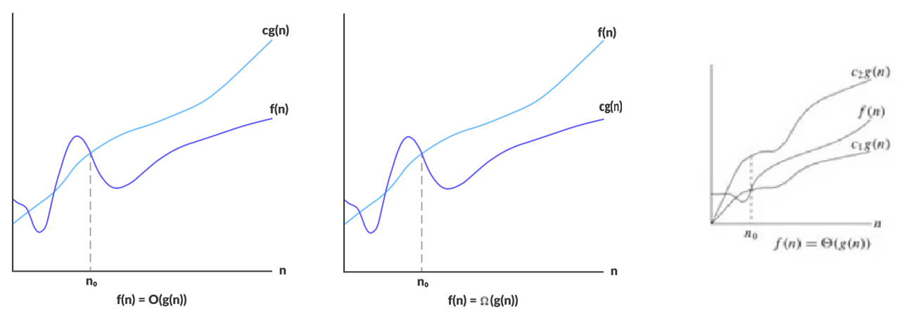

Slide 25
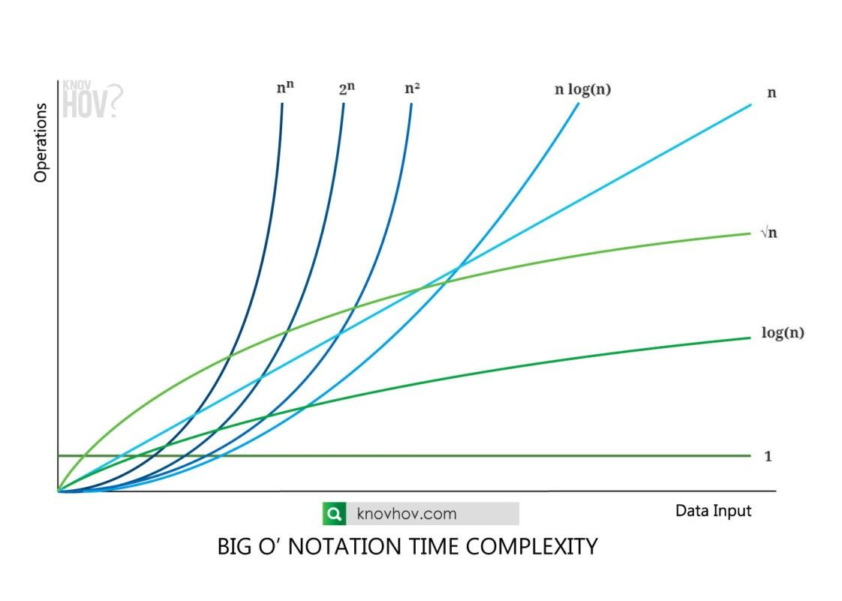

Slide 26

2.1 Worst-Case Analysis

Slide 27

Definition and Importance
Worst-case analysis considers the maximum time or space an algorithm requires for any input of size n
Important for ensuring performance guarantees and avoiding unexpected delays
Identify the worst possible input for the algorithm
Calculate the time or space taken for this input.

Slide 28
Calculate the complexity
for i in range(N):
a = a + 10
# This loop runs for M time
for i in range(M):
b = b + 40
# Nested loops
for i in range(N):
for j in range(M):
a = a + j
# Print the current
# value of a
print(a, end = " ")
while (i > 0):
# Print the value of a
print(a, end = ' ')
a = a + i
# Update i
i = i // 2

Slide 29
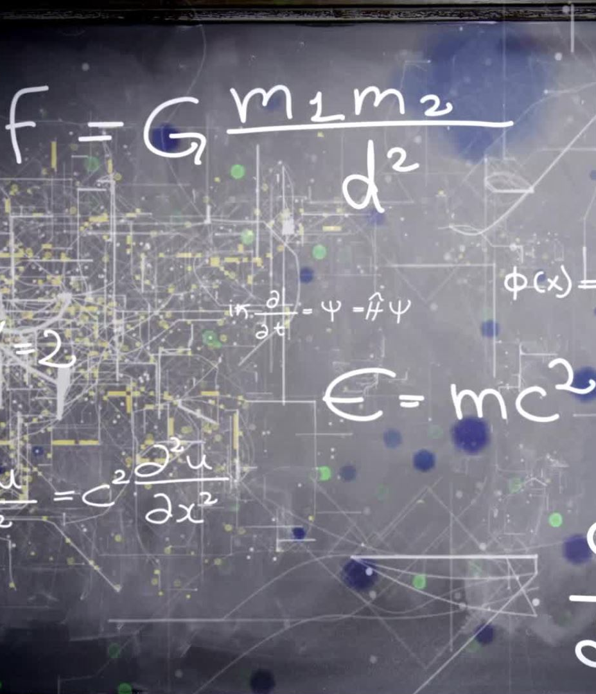
2.2 Taxonomies of Algorithm Complexity
Describes the upper bound of an algorithm’s running time
Focuses on the growth rate of the running time as input size increases
Constant: O(1)
Logarithmic: O (log(n))
Linear: O(n)
Quadratic: O(n^2)
Exponential: O(2^n)

Slide 30
Comparing Algorithms
Helps determine which algorithm is more efficient for large inputs
Example: MergeSort vs. BubbleSort

Slide 31

3. Analysing the Effectiveness and Efficiency of Algorithms
Effectiveness relates to the ability to produce the desired result.
A good algorithm is correct, but a great algorithm is both correct and efficient.
The most efficient algorithm is one that takes the least amount of execution time and memory usage possible while still yielding a correct answer.

Slide 32
Theoretical analysis vs Empirical analysis
The number of operations does not tell us the amount of time a computer will take to actually run an algorithm. The running time depends on implementation details like the speed of the computer, the programming language, and the translation of the language into machine code. That's why we typically describe efficiency in terms of number of operations.
To measure the run time, we must make the algorithm runnable; we must implement it in an actual programming language.

Slide 33

3.1 Measuring Algorithm Effectiveness

Slide 34

Criteria for Evaluation
Correctness: Does the algorithm produce the correct output for all valid inputs?
Completeness: Does the algorithm handle all possible inputs and edge cases?
Optimality: Does the algorithm produce the best possible solution?
Unit tests: Test individual components of the algorithm
Integration tests: Test the algorithm as a whole
Case studies: Real-world examples to validate effectiveness

Slide 35

3.2 Evaluating Algorithm Efficiency
Time complexity: Measures the time an algorithm takes to complete
Space complexity: Measures the amount of memory an algorithm uses
Both are typically measured in terms of input size n
Time vs. space: Faster algorithms may use more memory, and vice versa
Readability vs. performance: More efficient algorithms can be harder to understand and maintain
Profilers: Tools that measure the time and memory usage of code
Benchmarks: Standardized tests to compare the performance of different algorithms

Slide 36

3.3 Comparative Analysis
Empirical analysis: Run the algorithms on various inputs and measure performance
Theoretical analysis: Use mathematical techniques to derive time and space complexity
Advantages: Provides insights into the best algorithm for a given problem
Limitations: May not account for all real-world factors

Slide 37

Real-World Examples
Swapping of variable
Using 3 variables
Using 2 variables

Slide 38

4. Measuring Time and Space Complexity of Algorithms

Slide 39

4.1 Time Complexity

Slide 40

Definition and Significance
Time complexity describes the amount of time an algorithm takes to complete as a function of the input size n
Helps predict the performance of algorithms as input size grows
Identify the basic operations performed by the algorithm
Count the number of times each operation is executed
Linear Search: O(n) as it checks each element
MergeSort: O(n log(n)) due to dividing the array and merging subarrays

Slide 41
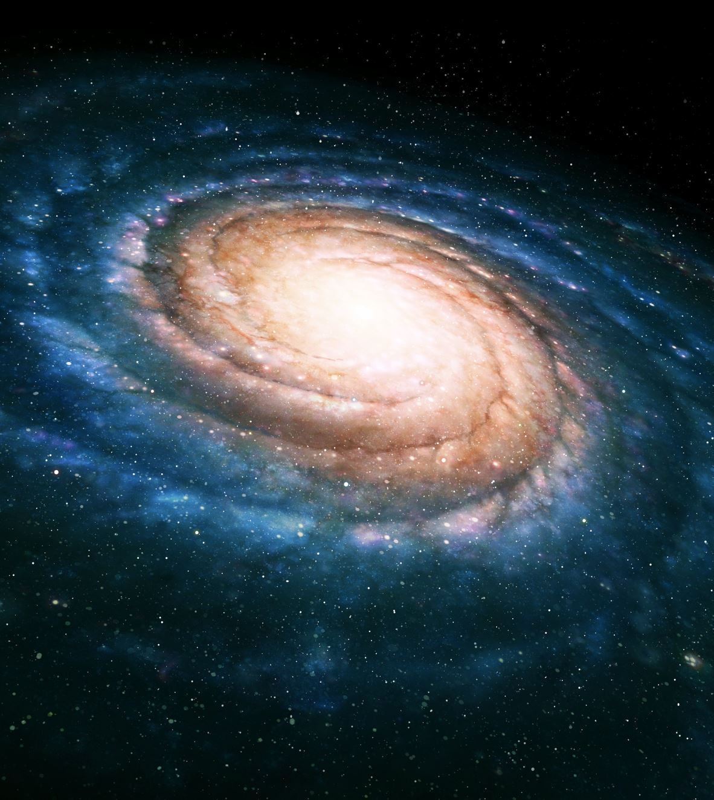
4.2 Space Complexity

Slide 42
Definition and Importance
Space complexity describes the amount of memory an algorithm uses as a function of the input size n.
Important for understanding the memory requirements of an algorithm.

Slide 43

Measuring Space Usage
Account for all memory used, including input data, auxiliary structures, and recursion stack
In-Place Sorting Algorithms: O extra space
Dynamic Programming: O(n) or O(n^2) depending on the problem

Slide 44

4.3 Asymptotic Analysis

Slide 45
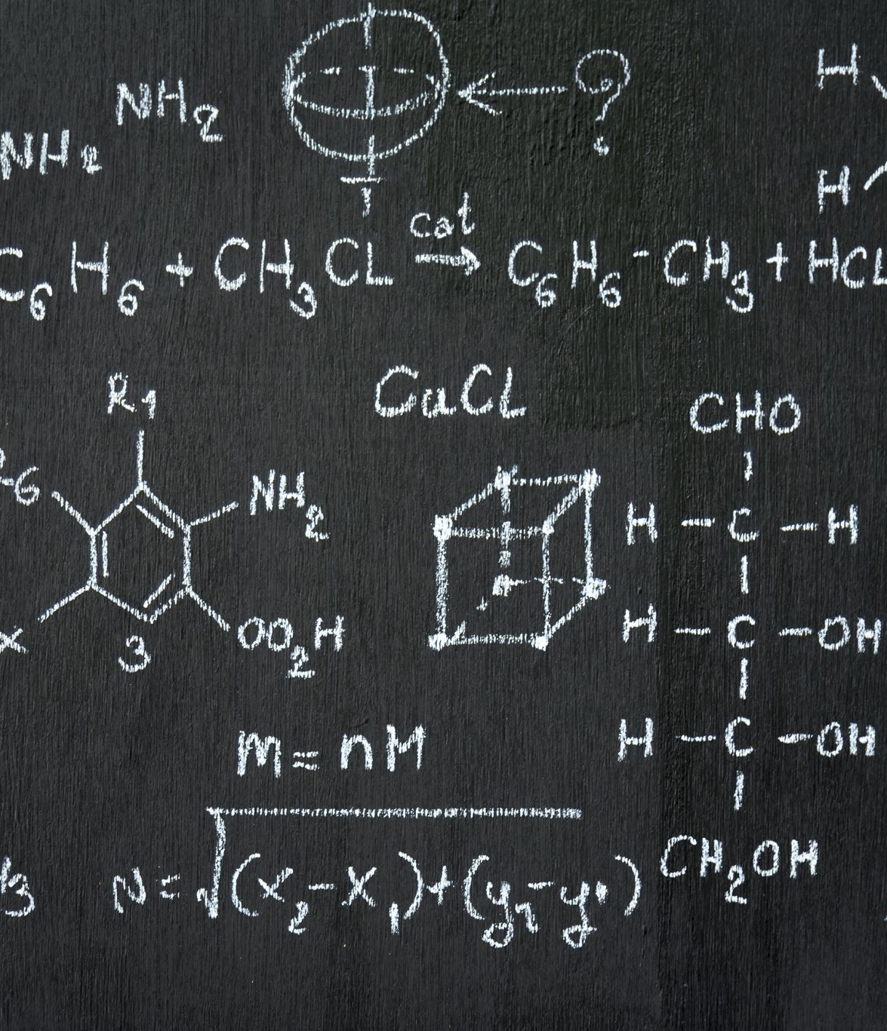
Asymptotic Notation
Big O: Upper bound
Big Theta : Tight bound
Big Omega : Lower bound
Provides a high-level understanding of algorithm performance
Helps compare algorithms without implementation details

Slide 46

Common Pitfalls
Ignoring
constant factors and
lower-order terms
that might be significant for small inputs.
Misinterpreting asymptotic notation as an exact measure.

Slide 47

5. Trade-off Concept in Algorithms

Slide 48

5.1 Introduction to Trade-offs
Trade-offs involve balancing different factors when designing or choosing algorithms
Important for optimizing overall performance based on specific needs

Slide 49

Types of Trade-offs
Time vs. space: Faster algorithms may use more memory
Accuracy vs. efficiency: More accurate solutions may be less efficient

Slide 50

5.2 Balancing Time and Space
Identify the critical resource based on the problem requirements
Use efficient data structures and algorithms to optimize both
Hash Tables: Use more memory for faster lookup times
Compression Algorithms: Use more time to reduce memory usage
Consider the environment
Weigh the pros and cons of each approach

Slide 51

5.3 Real-World Trade-offs
Sorting Large Datasets: Choosing between QuickSort and MergeSort based on available memory
Web Search Engines: Balancing indexing speed and search accuracy

Slide 52
Basis for comparison | Quick Sort | Merge Sort
The partition of elements in the array | The splitting of a array of elements is in any ratio, not necessarily divided into half. | In the merge sort, the array is parted into just 2 halves (i.e. n/2).
Worst case complexity | O(n^2) | O(nlogn)
Works well on | It works well on smaller array | It operates fine on any size of array
Additional storage space requirement | Less(In-place) | More(not In-place)
Efficiency | Inefficient for larger arrays | More efficient
Stability | Not Stable | Stable
Preferred for | for Arrays | for Linked Lists
Major work | The major work is to partition the array into two sub-arrays before sorting them recursively. | Major work is to combine the two sub-arrays after sorting them recursively.
Space | Quicksort does not require additional array space. | For merging of sorted sub-arrays, it needs a temporary array with the size equal to the number of input elements.

Slide 53

Industry Practices
Use of heuristic methods to find acceptable solutions quickly
Optimization techniques to balance various performance metrics
Essential for fine-tuning algorithms in real-world applications
Helps achieve the best possible performance within given constraints

Slide 54

Suggested Readings and Resources
"Introduction to Algorithms" by Thomas H. Cormen, Charles E. Leiserson, Ronald L. Rivest, and Clifford Stein
"Algorithm Design" by Jon Kleinberg and Éva Tardos
Online platforms: Coursera, edX, Khan Academy
Research papers and case studies for practical insights

